Slide 1
State Employment Agency of Latvia
Eva Lapsiņa
Director of Developement and Analitic Department
13.09.2022

Slide 2
STATE EMPLOYMENT AGENCY OF LATVIA
PURPOSE
To implement the state policy in the field of unemployment reduction and support for the unemployed, job seekers and persons at risk of unemployment.
FOUNDED -
APRIL 17, 1991
MAIN TASKS
CENTRAL OFFICE
1
Registration of unemployed and job seekers (provide job search support)
Registration of vacancies, provide services for employers
ALMPs, career guidance
Short term labour market forecasts
Registration of companies providing placement services
EURES (European Employment Services) activities
Member of the European network of Public Employment Service
20
BRANCHES

Slide 3
ORGANIZATIONAL STRUCTURE OF THE SEA

Slide 4
CUSTOMER SERVICE POINTS OF THE SEA
NUMBER OF REGISTERED UNEMPLOYED

Slide 5
FUNCTIONS, TASKS OF SEA BRANCHES
The branch offices serve our customers - they provide support to jobseekers and employers by offering various services.
The branches are directly subordinated to one of the deputy directors, who manages the work of the branches.
In order to more effectively solve branch problems, a Branch managers' council has been established, where one branch manager from each region, as well as the head of the council, is elected. The frequency of council meetings and work organization is determined by the head of the council.
All branches together with management team meet once a quarter at the branch manager Information day, where branches are informed about news and problematic issues.

Slide 6
LABOUR MARKET OUTLOOK IN LATVIA
LATVIA
Valmiera
Ventspils
REGISTERED VACANCIES (31.07.2022.)
KURZEMES
REGION
6,0%
RIGA
REGION
4,5%
NUMBER OF REGISTERED UNEMPLOYED (31.07.2022.)
Jūrmala
Rīga
VIDZEMES
REGION
6,1%
LATGALES
REGION
12,9%
Jelgava
Liepāja
ZEMGALES REGION
5,6%
Jēkabpils
Rēzekne
NUMBER OF EMPLOYERS
(01.01.2021.)
EMPLOYED POPULATION
(15-74 age)
(2021. year)
Daugavpils
POPULATION OF WORKING AGE
(2022. year)
CURRENT REGISTERED UNEMPLOYMENT RATE 6,0%

Slide 7
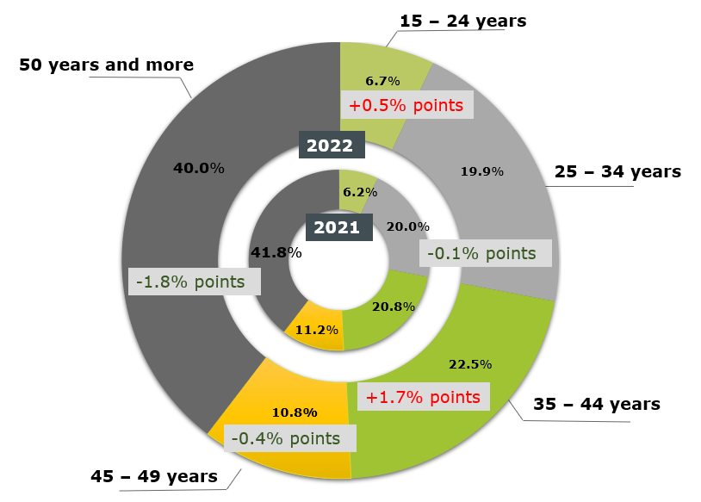
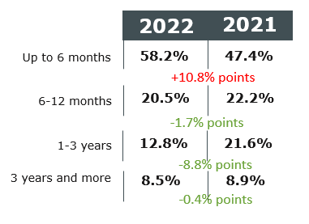
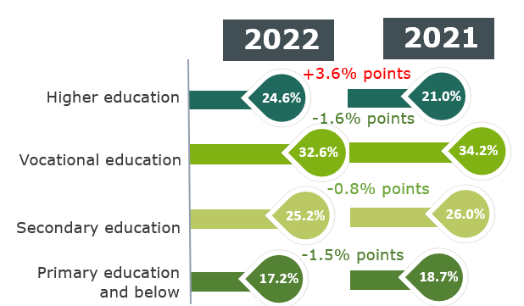
Bezdarbnieka portrets (kopumā) (izmaiņas salīdzinājumā ar 31.08.2021.)
Portrait of an UnemployeD (changes compared to 31.08.2021)
DURATION OF UNEMPLOYMENT
AGE GROUPS
EDUCATION LEVEL
51 527
the number of registered unemployed
at the end of August 2022
59 040
the number of registered unemployed
at the end of August 2021
Changes: -7 513 persons or -12.7%
(31.08.2022, SEA DATA)

Slide 8
SHORT TERM LABOUR MARKET FORECASTS
HISTORY OF FORECASTING
2010 – 2014
SEA
2016 – 2022
SEA in cooperation with MoE
Project “Development of the Labor Market Forecasting and Monitoring System of the State Employment Agency”
Project “Improvement of the Labor Market Forecasting System” and
“Establishment of a labor supply and demand forecasting and monitoring system”

Slide 9
SHORT TERM LABOUR MARKET FORECASTS
DATA SOURCES AND ECONOMETRIC MODELS
Labor Force Surveys (CSB)
Actual (past) employment data by industry (Eurostat)
Actual (past) data on real value added by industry (Eurostat)
Employment forecasts by industry
+ forecasts by occupations and regions
Adjusted forecasts
+ skill forecasts
MoE value added forecasts by industry
data on registered employees, employees by age (SRS)
Employer survey data
Skill set matrix

Slide 10
SHORT TERM LABOUR MARKET FORECASTS
Policy makers
Universities
planning education and training programs
development of study programs
Scientists, researchers
Career counsellors
labor market researches
career choices for adults and young people
Who and when can use this tool?
Employers
Adults
business expansion, personnel policy
looking for a career change
Industry associations
Parents and young people
investments
future education and profession

Slide 11
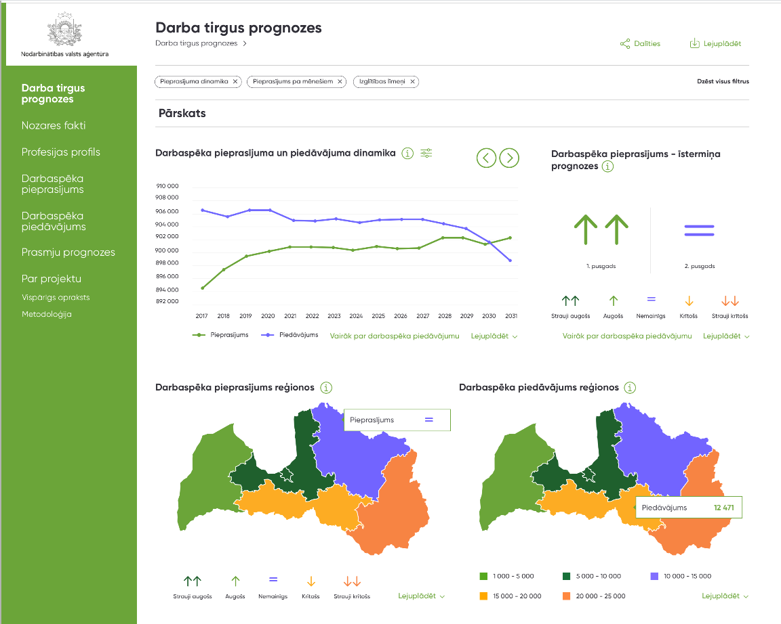
SHORT TERM LABOUR MARKET FORECASTS
https://prognozes.nva.gov.lv/lv
https://prognozes.em.gov.lv/lv

Slide 12
SEA PLANNING DOCUMENTS
1
4
Strategy of the State Employment Agency for 2021-2023
KPI (key performance indicators) for budget planning documents
3
Management review of the Ministry of Welfare – resulting tasks for the Agency
2
5
Annual Work Plan
etc. documents and tasks resulting from them

Slide 13
Strategy
2021 – 2023
MISSION
The Agency promotes inclusive and sustainable employment in cooperation with employers and partners
VISION
VALUES
The Agency is the leading institution in personnel recruitment
Professionalism
Responsibility
Cooperation
Efficiency

Slide 14
To improve the personnel selection support service provided by the Agency and promote the provision of preventive support services to clients
Introduce individualized support and a sequential range of services for more successful integration into the labor market, incl. implementing preventive support services
Strategy goal map 2021 – 2023
Promote the popularity of CV and vacancy portal
Improve careers service system
Activate the cooperation with employers
Increase return to employment
Promote societies and the employer informing about the potential of persons with disabilities in the labor market
Support for employers, increasing their involvement in the use of Agency services
1.
Promote the Agency's role as a leading partner in personnel recruitment
2.
Integration of persons with disabilities into the labor market
Implementation of activities related to the remigration initiative
Provide information and services availability to individuals with a disability on the agency's website and in communication with clients
Strengthening the labor market analytical capacitie
Provide co-operation with other European employment Agencies for exchanging good experience
3.
Implemented personnel policy in accordance with current trends in the field of human resources
Improving the accessibility of the environment
Strengthening employee performance
Employee satisfaction with work in the Agency
Internal training system based on competences and performance improvement
The agency as a modern institution with a flexible work environment
Collaborative and internal learning method/approach/culture

Slide 15
Thank you!

