Slide 1
Karjeras atbalsta nozīmīgums Ilze Astrīda Jansone Euroguidance programma, Valsts izglītības attīstības aģentūra

Slide 2
Pasaules ekspertu viedoklis
2019.
Kopīgā publikācija par ieguldījumiem karjeras attīstības atbalstā (Eiropas Komisija, ETF, CEDEFOP, OECD, UNESCO)
2020.
OECD pētījumi par jauniešu «sapņu karjeru» un par skolu lomu jauniešu sagatavošanā darba tirgum COVID apstākļos
Eiropas Komisijas Pētniecības centra apskats par attālināto darbu

Slide 3
Euroguidance
Eiropas karjeras atbalsta veicināšanas tīkls
nodrošina informāciju par mobilitāti mācību nolūkos
Notes:
Eiropas karjeras atbalsta un mobilitātes informācijas centru tīkls ES un EEZ valstīs

Slide 4
Karjeras atbalsta definīcija:
Pakalpojumi, kas palīdz cilvēkiem jebkurā vecumā pārvaldīt savu karjeru, un pieņemt atbilstošus lēmumus par izglītību, mācībām un darbu ņemot vērā vēlmes, intereses, kvalifikācijas, prasmes un talantus, kā arī darba tirgus stāvokli.
Notes:
‘a continuous process that enables citizens at any age and at any point in their lives to identify their capacities, competences and interests, to make education, training and occupation decisions and to manage their individual life paths in learning, work and other settings in which those capacities and competences are learned and/or used. Guidance covers a range of individual and collective activities relating to information-giving, counselling, competence assessment, support, and the teaching of decision-making and career management skills’
Career guidance1 describes the services which help people of any age to manage their careers and to make the educational, training and occupational choices that are right for them. It helps people to reflect on their ambitions, interests, qualifications, skills and talents - and to relate this knowledge about who they are to who they might become within the labour market.
Career guidance involves a range of connected activities, including provision of careers information, personalised guidance/counselling, skills assessment, engaging with the world of work and the teaching of decision-making and career management skills. Career guidance is delivered face-to-face, by telephone and online. Career guidance is a continuous process throughout life. It is critical to the smooth transitions of young people as they make choices about education and training and to the mobility and (re)engagement of adults within the labour market. Guidance is provided to people in a wide range of settings: schools and training centres, tertiary and higher education institutions; employment services and career guidance centres; in workplaces, trade unions and professional bodies as well as in local community settings.

Slide 5
Aktualitāte
izglītības ilgums = vairāk lēmumu par nākamajiem posmiem
mācību un darba piedāvājumu plašums
sociālās nevienlīdzības kavēkļi
dzimumu stereotipi

Slide 6
Maznodrošināto jauniešu īpašie izaicinājumi
Šaurs redzes loks
Trūkst izpratnes par izglītības un nodarbinātības kopsakarībām
Neticība savam potenciālam
Retāka dalība karjeras atbalsta pasākumos
Notes:
2018. Gada PISA rezultāti par Latvijas jauniešiem liecina, ka no tiem jauniešiem kam ir labas zināšanas, 10% no turīgām ģimenēm necer studēt, bet 40% no maznodrošinātajiem jauniešiem necer studēt.
Results from PISA show that the career aspirations of young people are no simple reflection of teenage academic ability. Rather, they reflect complex lives. Analyses show that even after controlling for proficiency
levels, the children of more advantaged families are more likely to want to go on to university than working class kids. Similarly, career thinking is often driven by gender and immigrant background as well as socioeconomic
status. Disadvantaged young people are at clear risk of career confusion. It is neither equitable, nor efficient, for students to move through education with blinkered views of both the breadth of the labour market and their own potential.
1. Career concentration: the extent to which young people’s occupational expectations are concentrated in the ten most commonly cited jobs, how they have changed over time and how they vary between
different types of learner.
2. Labour market relevance: how young people’s occupational expectations are related to national projections of labour market demand.
3. Job realism: the risk that the jobs young people expect to be pursuing at age 30 will become automated.
4. Career potential: whether occupational expectations reflect the academic potential of students.
5. Career confusion: the extent to which students are misaligned in their educational and occupational expectations.
6. Providing guidance: whether participation in career development activities can be seen to make a difference to career thinking.
7. Career participation: how participation in career development activities has changed over time and varies between different types of learner.
For young people, we know that:
• they are making more decisions than before as they stay in education longer, but the increasing dynamism of the labour market, the rapidly changing demand for skills and the growing diversification and fragmentation of education and training provision is making decision-making more difficult. • what they think about their future careers makes a difference to what happens to them in adulthood, but career aspirations are often narrow, unrealistic and distorted by social background.
• frequently they have limited awareness of their own potential and needs and low access to impartial information about learning and funding possibilities, becoming demotivated with education and training.
• many occupations and learning routes, such as apprenticeships in some countries, are poorly understood or stereotyped, contributing to skills shortages and leading, in some cases, to educational disengagement and dropout.
• participation in some career guidance activities, such as short career exploration work placements, is commonly linked to the social background of learners, running the risk of inequitable outcomes.
• participation in career guidance activities is associated with educational and particularly economic gains, but far too few young people have sufficient access to the information they need.
For adults, we know that:
• technological advances are driving massive changes in the labour market – old jobs and skills are disappearing or radically changing and new jobs and skills are emerging. Re-skilling and upskilling are increasingly seen as integral parts of working life.
• people are working longer and moving between countries more frequently.
• some job losers have fallen into situations of long-term unemployment and inactivity, being demotivated, with outdated skills and weak knowledge of learning options. • new forms and ways of working mean that individuals are increasingly responsible for their own education and training.
• guidance is essential to people who want to validate skills obtained outside formal learning contexts.
• European surveys show most adults recognise that career guidance is useful for finding and choosing suitable jobs, courses and other opportunities, but fewer than one in three people ever use a career guidance service.
• individuals with lower levels of qualifications are much less likely to use career guidance – but are more likely to need it because their jobs are at greater risk of automation.

Slide 7
Efektīvs karjeras atbalsts:
Pieejams jau no pamatskolas un pastiprinās lēmumu pieņemšanas laikā
Sasaista mācības ar nākotnes darbu
Sniedz pārbaudītu un objektīvu darba tirgus informāciju
Novērš informācijas trūkumu un stereotipus
Paplašina izpratni par darba tirgu kopumā un īpaši par aktuālākajām profesijām
Pievērš sevišķu uzmanību jauniešiem, kas atrodas sociāli nelabvēlīgos apstākļos
Nodrošina reālu saskari ar darba tirgu, iesaistot darba devējus
Notes:
Effective career guidance encourages students to reflect on who they are and who they wantto become, and to think critically about the relationships between their educational choices and future economic
life. Experience of the world of work gives young people the opportunity to apply their skills and knowledge in unfamiliar situations. It challenges them to understand what it means to be personally effective
(and attractive to employers) in distinct workplaces while providing a unique opportunity to develop social networks of value. Through exposure to the people who do different jobs, young people have the chance to
challenge gender- and class-based stereotyping and broaden their aspirations, easing ultimate entry into the labour market (Box 0.2).

Slide 8
Kā mazināt COVID ietekmi?
Domāt par karjeru – mazināt neziņu, neizlēmīgumu, neizpratni
Izpētīt karjeru – piedalīties karjeras izglītībā, sarunās ar pieredzējušiem speciālistiem, ēnošanā
Gūt karjeras pieredzi – strādāt vasarā, paralēli mācībām, arī kā brīvprātīgajam
Notes:
Young people suffer disproportionately in any recession and that initiated by the COVID-19 pandemic promises to be no exception. Lacking useful work experience, information and contacts, young people struggle to compete for available employment. Analysis of national longitudinal data shows however, that reliable indicators exist of young people’s career readiness: better than anticipated adult employment outcomes are statistically
connected to (i) what teenagers think about their futures in work, (ii) the extent to which they explore potential futures, and (iii) whether they gain workplace experience while still in school. Collectively, such data-driven indicators reveal greater student agency in approaching school-to-work transitions.

Slide 9
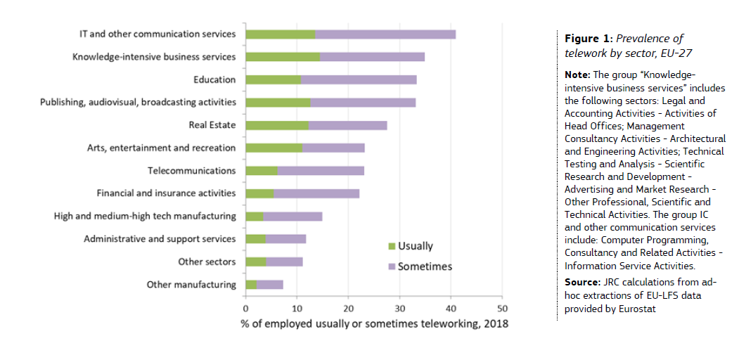
Te ir (e-)darbs!

Slide 10
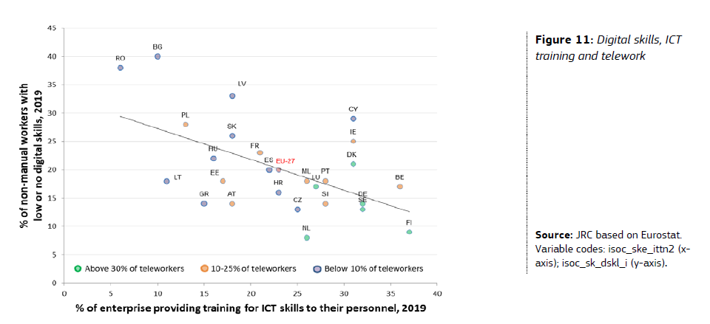
Tālākizglītības vajadzība #1

Slide 11
Karjeras atbalsta nozīmīgums
Indivīdi īsteno potenciālu, laicīgi saņemot objektīvu informāciju un atbalstu
Tautsaimniecība kļūst efektīvāka, attīstoties radošumam un inovācijām
Sabiedrība kļūst taisnīgāka, sekmējot mūžizglītību un nodarbināmību
Notes:
Effective career guidance helps individuals to reach their potential, economies to become more efficient and societies to become fairer. It provides people with personalised, impartial and timely information
and support to make informed decisions about their lives. It acts as a lubricant for developing and nurturing human talent to power innovation, creativity and competitiveness. It helps to implement lifelong
approaches to learning and active approaches to labour market engagement and transition. As the working world becomes increasingly complex, career guidance is becoming ever more important to
individuals, employers and to society.

Slide 12
Avoti
Investing in Guidance, The Inter-Agency Working Group on Work-based Learning, 17/12/2019 https://www.cedefop.europa.eu/en/publications-and-resources/publications/2227
Dream Jobs? Teenagers’ Career Aspirations and the Future of Work, Mann, A., et al. (2020), OECD Publishing http://www.oecd.org/education/dream-jobs-teenagers-career-aspirations-and-the-future-of-work.htm
Mann, A., Denis V., Percy C. (2020), "Career ready?: How schools can better prepare young people for working life in the era of COVID-19", OECD Education Working Papers, No. 241, OECD Publishing, Paris, https://doi.org/10.1787/e1503534-en.
EU Science for Policy Briefs: Telework in the EU before and after the COVID-19: where we were, where we head to

Slide 13
Jautājumiem:
Ilze Astrīda Jansone
VIAA Informācijas un karjeras atbalsta departaments
Tālr.: 67830829; 29143313
e-pasts: ilze.jansone@viaa.gov.lv

